Slide 1
Sending Player Movement

Slide 2
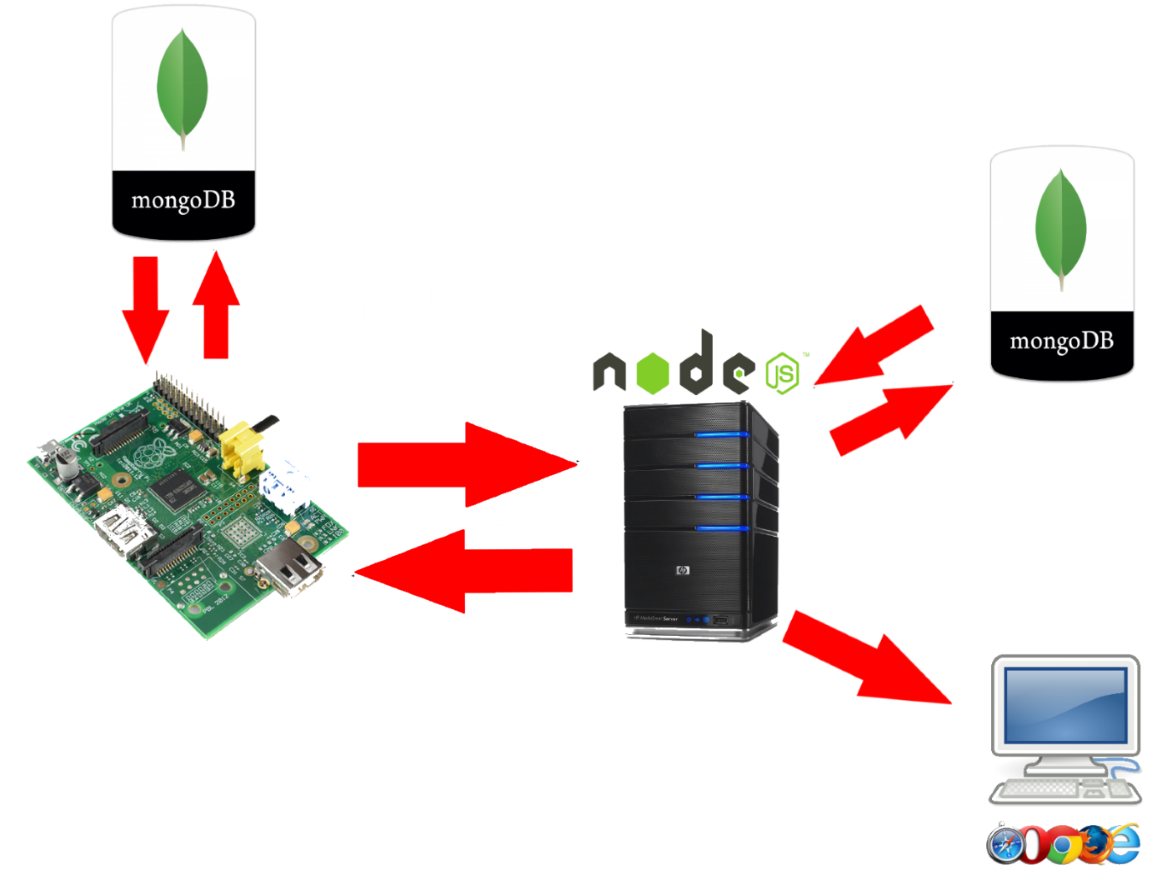

Slide 3
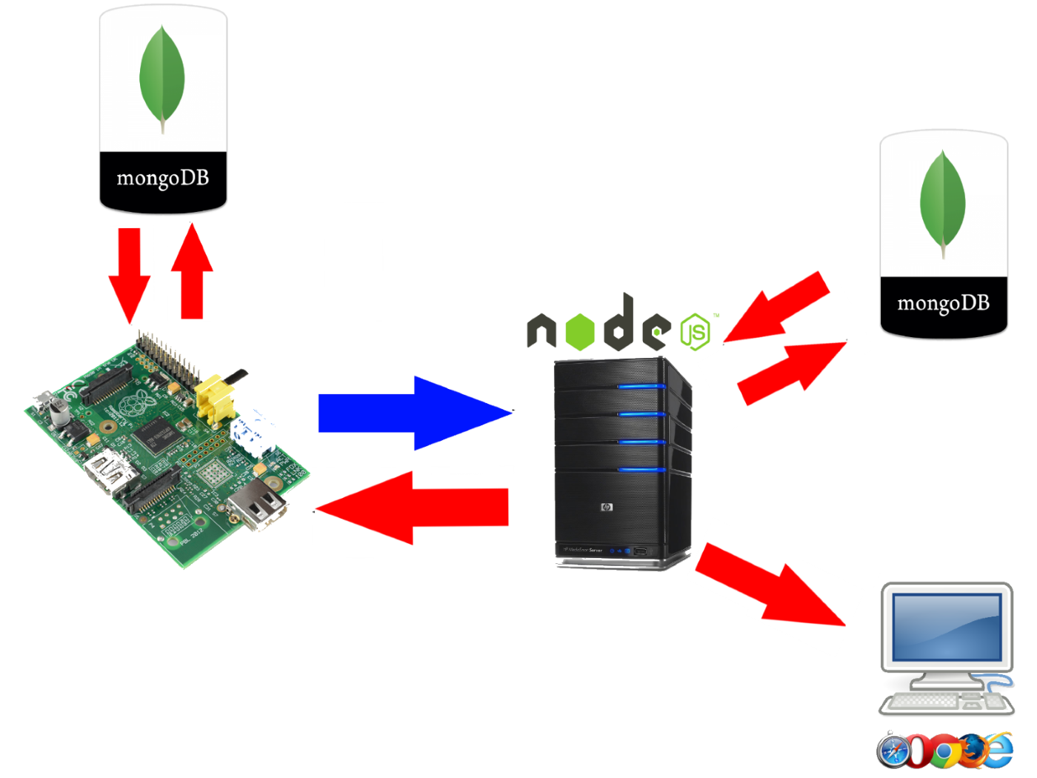

Slide 4
Confirms direction sent is valid
Confirms Player can move

Slide 5
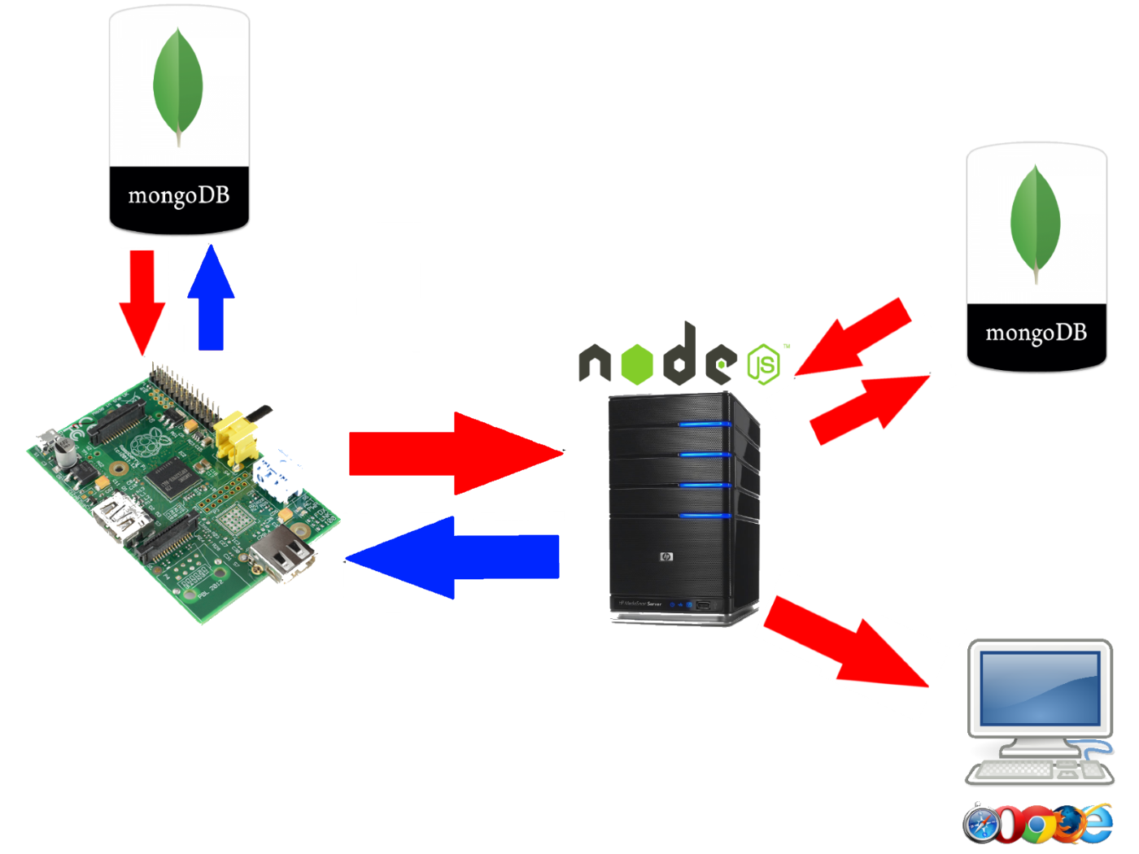

Slide 6
Saves data to database
Returns confirmation it saved

Slide 7
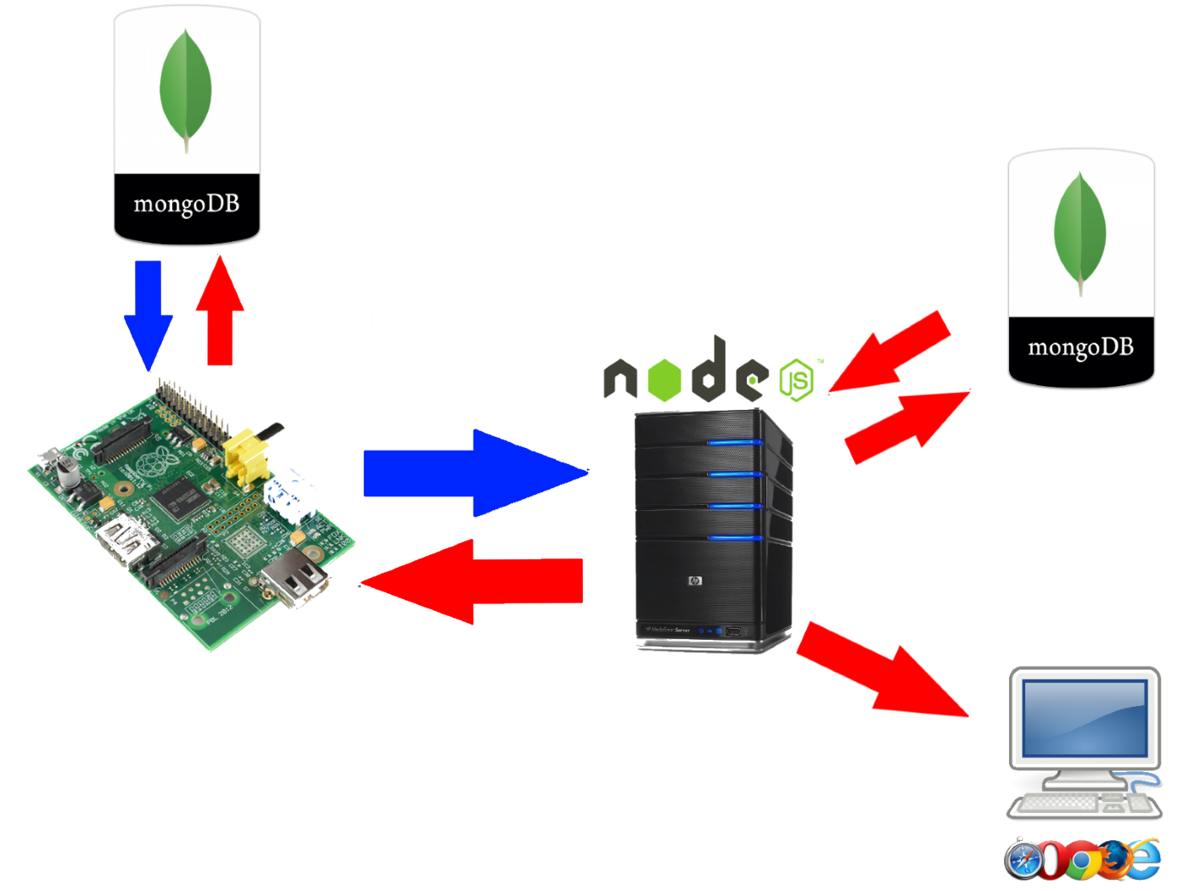

Slide 8
Emits socket message to everyone

Slide 9
